Slide 1
Calendar App
The purpose of calendar app is to track the upcoming meetings deadlines, and schedules and also activities. It can help you to visualize your schedules and remind you of the important events, such as holidays and vacation time.

Slide 2
Description
Calendar app is to help the users to manage the time efficiently and effectively.

Slide 3
Introduction
The calendar app is to give you a reminder about a certain day. It will help you to guide your day to be productive. It’s a service which tells its users what they should do in the next day or following day. By building a calendar application, you meet a certain demand. What kind of demand and why? It’s pretty clear! Let’s be honestly admit, nowadays our schedule is getting complicated because there is a lot things to do in a day. This calendar app gives you the time, schedule, and reminder to achieve your scheduled task. Wherever we are now in the city, vacation, or in a business trip in any case, we need to know what to expect on our life. And since we don’t have the gift of prophesy, we sort to the help of relevant services.

Slide 4
Scope and Limitation
This project proposal is mainly concerned and focuses on the development of Calendar app so it will remind you to what are you up to this day and the following day. It will help notify you in a specific task whether you are in work or home.

Slide 5
Process
1. Step 1: Visualize your workflow. Create or add task you want to do.
2. Step 2: Identify the types of works or task you want to do.

Slide 6
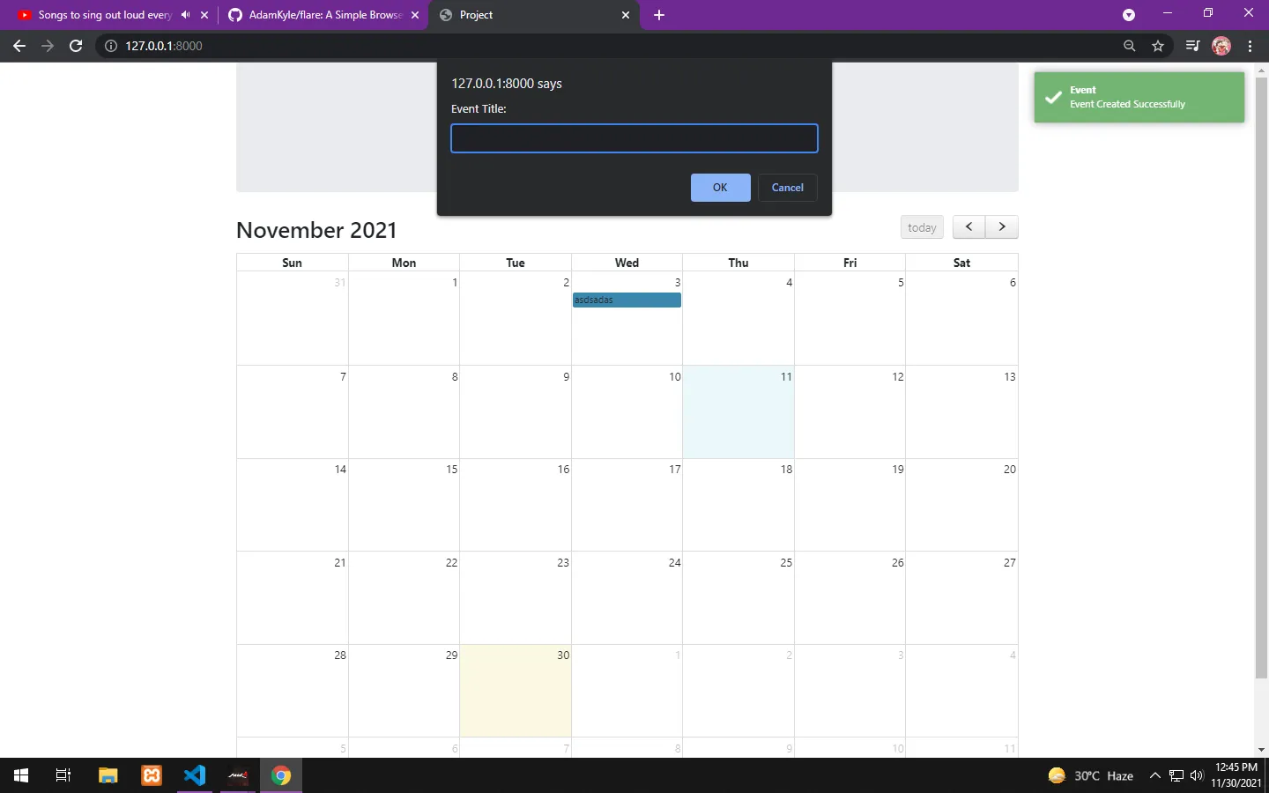

Slide 7
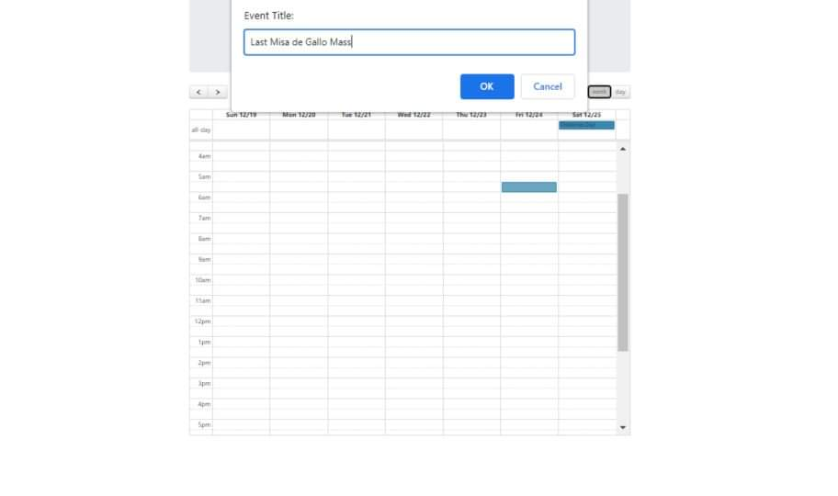

Slide 8
